Slide 1
COMP 2710 Software Construction
File I/O
Dr. Alvin Lim
Auburn University
http://www.eng.auburn.edu/~lim
limalvi@auburn.edu
Fall 2014
These slides are adapted from notes by Dr. Walter Savitch (UCSD)
Notes:
Objectives:
I/O Streams
File I/O
Character I/O
Tools for Stream I/O
File names as input
Formatting output, flag settings
Stream Hierarchies
Preview of inheritance
Random Access to Files

Slide 2
Introduction
Streams
  Special objects
  Deliver program input and output
File I/O
  Uses inheritance
    Not covered until chapter 14
  File I/O very useful, so covered here
Copyright © 2008 Pearson Addison-Wesley. All rights reserved.
12-<number>

Slide 3
Streams
A flow of characters
Input stream
  Flow into program
    Can come from keyboard
    Can come from file
Output stream
  Flow out of program
    Can go to screen
    Can go to file
Copyright © 2008 Pearson Addison-Wesley. All rights reserved.
12-<number>

Slide 4



Streams Usage
We’ve used streams already
  cin
    Input stream object connected to keyboard
  cout
    Output stream object connected to screen
Can define other streams
  To or from files
  Used similarly as cin, cout
12-<number>

Slide 5
Streams Usage Like cin, cout
Consider:
  Given program defines stream inStream
  that comes from some file:
  int theNumber;
  inStream >> theNumber;
    Reads value from stream, assigned to theNumber
  Program defines stream outStream that goes
  to some file
  outStream << "theNumber is " << theNumber;
    Writes value to stream, which goes to file
Copyright © 2008 Pearson Addison-Wesley. All rights reserved.
12-<number>

Slide 6
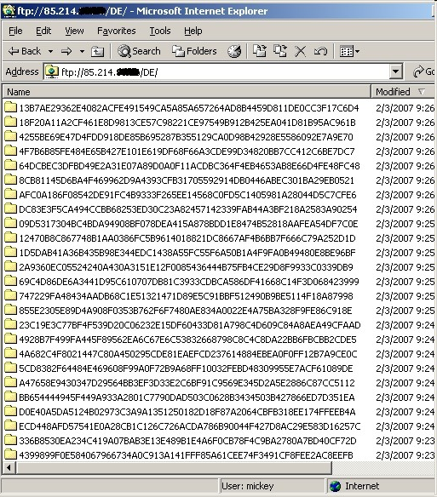
Files
We’ll use text files
Reading from file
  When program takes input
Writing to file
  When program sends output
Start at beginning of file to end
  Other methods available
  We’ll discuss this simple text file access here
Copyright © 2008 Pearson Addison-Wesley. All rights reserved.
12-<number>

Slide 7
File Connection
Must first connect file to stream object
For input:
  File → ifstream object
For output:
  File → ofstream object
Classes ifstream and ofstream
  Defined in library <fstream>
  Named in std namespace
Copyright © 2008 Pearson Addison-Wesley. All rights reserved.
12-<number>

Slide 8
File I/O Libraries
To allow both file input and output in your
program:
#include <fstream>
using namespace std;
OR
#include <fstream>
using std::ifstream;
using std::ofstream;
Copyright © 2008 Pearson Addison-Wesley. All rights reserved.
12-<number>

Slide 9
Declaring Streams
Stream must be declared like any other
class variable:
ifstream inStream;
ofstream outStream;
Must then "connect" to file:
inStream.open("infile.txt");
  Called "opening the file"
  Uses member function open
  Can specify complete pathname
Copyright © 2008 Pearson Addison-Wesley. All rights reserved.
12-<number>
Notes:
Declare; Open; and Use.

Slide 10
Streams Usage
Once declared → use normally!
int oneNumber, anotherNumber;
inStream >> oneNumber >> anotherNumber;
Output stream similar:
ofstream outStream;
outStream.open("outfile.txt");
outStream << "oneNumber = " << oneNumber
<< " anotherNumber = "
<< anotherNumber;
  Sends items to output file
Copyright © 2008 Pearson Addison-Wesley. All rights reserved.
12-<number>

Slide 11
File Names
Programs and files
Files have two names to our programs
  External file name
    Also called "physical file name"
    Like "infile.txt"
    Sometimes considered "real file name"
    Used only once in program (to open)
  Stream name
    Also called "logical file name"
    Program uses this name for all file activity
Copyright © 2008 Pearson Addison-Wesley. All rights reserved.
12-<number>

Slide 12
Closing Files
Files should be closed
  When program completed getting input or
  sending output
  Disconnects stream from file
  In action:
  inStream.close();
  outStream.close();
    Note no arguments
Files automatically close when program ends
Copyright © 2008 Pearson Addison-Wesley. All rights reserved.
12-<number>

Slide 13
File Flush
Output often "buffered"
  Temporarily stored before written to file
  Written in "groups"
Occasionally might need to force writing:
outStream.flush();
  Member function flush, for all output streams
  All buffered output is physically written
Closing file automatically calls flush()
Copyright © 2008 Pearson Addison-Wesley. All rights reserved.
12-<number>

Slide 14
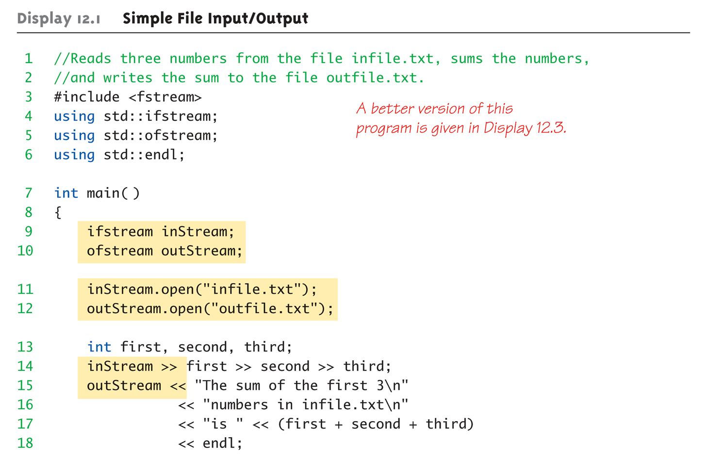
File Example:
Display 12.1 Simple File
Input/Output (1 of 2)
Copyright © 2008 Pearson Addison-Wesley. All rights reserved.
12-<number>

Slide 15
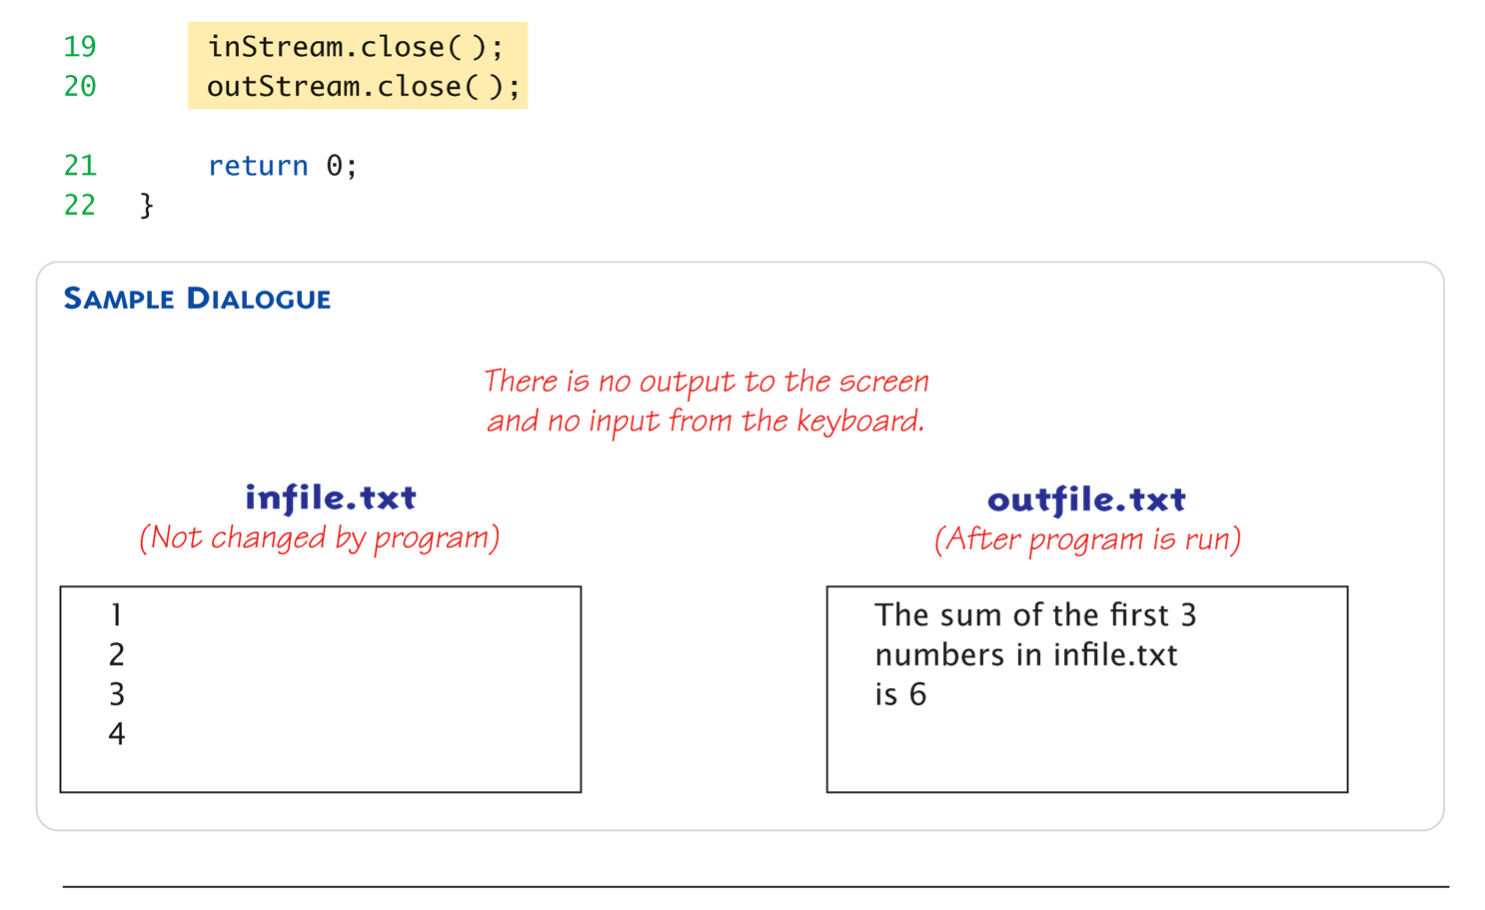
File Example:
Display 12.1 Simple File
Input/Output (1 of 2)
Copyright © 2008 Pearson Addison-Wesley. All rights reserved.
12-<number>

Slide 16
Appending to a File
Standard open operation begins with
empty file
  Even if file exists → contents lost
Open for append:
ofstream outStream;
outStream.open("important.txt", ios::app);
  If file doesn’t exist → creates it
  If file exists → appends to end
  2nd argument is class ios defined constant
    In <iostream> library, std namespace
Copyright © 2008 Pearson Addison-Wesley. All rights reserved.
12-<number>

Slide 17
Alternative Syntax for File Opens
Can specify filename at declaration
  Passed as argument to constructor
ifstream inStream;
inStream.open("infile.txt");
EQUIVALENT TO:
ifstream inStream("infile.txt");
Copyright © 2008 Pearson Addison-Wesley. All rights reserved.
12-<number>

Slide 18
Checking File Open Success
File opens could fail
  If input file doesn’t exist
  No write permissions to output file
  Unexpected results
Member function fail()
  Place call to fail() to check stream operation
  success
  inStream.open("stuff.txt");
  if (inStream.fail())
  {
  cout << "File open failed.\n";
  exit(1);
  }
Copyright © 2008 Pearson Addison-Wesley. All rights reserved.
12-<number>

Slide 19
Character I/O with Files
All cin and cout character I/O same
for files!
Member functions work same:
  get, getline
  put, putback,
  peek, ignore
Copyright © 2008 Pearson Addison-Wesley. All rights reserved.
12-<number>

Slide 20
Checking End of File
Use loop to process file until end
  Typical approach
Two ways to test for end of file
  Member function eof()
  inStream.get(next);
  while (!inStream.eof())
  {
  cout << next;
  inStream.get(next);
  }
    Reads each character until file ends
    eof() member function returns bool
Copyright © 2008 Pearson Addison-Wesley. All rights reserved.
12-<number>

Slide 21
End of File Check with Read
Second method
  read operation returns bool value!
  (inStream >> next)
    Expression returns true if read successful
    Returns false if attempt to read beyond end of file
  In action:
  double next, sum = 0;
  while (inStream >> next)
  sum = sum + next;
  cout << "the sum is " << sum << endl;
Copyright © 2008 Pearson Addison-Wesley. All rights reserved.
12-<number>

Slide 22
Tools: File Names as Input
Stream open operation
  Argument to open() is c-string type
  Can be literal (used so far) or variable
  char fileName[16];
  ifstream inStream;
  cout << "Enter file name: ";
  cin >> fileName;
  inStream.open(fileName);
  Provides more flexibility
Copyright © 2008 Pearson Addison-Wesley. All rights reserved.
12-<number>

Slide 23
Formatting Output with Stream Functions
Recall chapter 1 "magic formula":
cout.setf(ios::fixed);
cout.setf(ios::showpoint);
cout.precision(2);
Outputs numbers in "money"
form (12.52)
Can use on any output stream
  File streams have same member functions
  as cout object
Copyright © 2008 Pearson Addison-Wesley. All rights reserved.
12-<number>

Slide 24
Output Member Functions
Consider:
outStream.setf(ios::fixed);
outStream.setf(ios::showpoint);
outStream.precision(2);
Member function precision(x)
  Decimals written with "x" digits after decimal
Member function setf()
  Allows multitude of output flags to be set
Copyright © 2008 Pearson Addison-Wesley. All rights reserved.
12-<number>

Slide 25
More Output Member Functions
Consider:
outStream.width(5);
Member function width(x)
  Sets width to "x" for outputted value
  Only affects "next" value outputted
  Must set width before each value in order to
  affect all
    Typical to have "varying" widths
    To form "columns"
Copyright © 2008 Pearson Addison-Wesley. All rights reserved.
12-<number>

Slide 26
Flags
Recall: member function setf()
  Sets condition of output flags
All output streams have setf() member
Flags are constants in class ios
  In library <iostream>, std namespace
Copyright © 2008 Pearson Addison-Wesley. All rights reserved.
12-<number>

Slide 27
setf() Examples
Common flag constants:
  outStream.setf(ios::fixed);
    Sets fixed-point notation (decimal)
  outStream.setf(ios::showPoint);
    Always include decimal point
  outStream.setf(ios::right);
    Sets right-justification
Set multiple flags with one call:
outStream.setf(ios::fixed | ios::showpoint |
ios::right);
Copyright © 2008 Pearson Addison-Wesley. All rights reserved.
12-<number>

Slide 28
Manipulators
Manipulator defined:
"A function called in nontraditional way"
  Can have arguments
  Placed after insertion operator
  Do same things as member functions!
    In different way
  Common to use both "together"
setw() and setprecision() are in library
<iomanip>, std namespace
Copyright © 2008 Pearson Addison-Wesley. All rights reserved.
12-<number>

Slide 29
Manipulator Example: setw()
setw() manipulator:
cout << "Start" << setw(4) << 10
<< setw(4) << 20 << setw(6) << 30;
  Results in:
  Start 10 20 30
Note: setw() affects only NEXT
outputted value
  Must include setw() manipulator before each
  outputted item to affect all
Copyright © 2008 Pearson Addison-Wesley. All rights reserved.
12-<number>

Slide 30
Manipulator setprecision()
setprecision() manipulator:
cout.setf(ios::fixed | ios::showpoint);
cout << "$" << setprecision(2) << 10.3 << " "
<< "$" << 20.5 << endl;
Results in:
$10.30 $20.50
Copyright © 2008 Pearson Addison-Wesley. All rights reserved.
12-<number>

Slide 31
Saving Flag Settings
Flag settings "stay" until changed
Precision and setf flags can be saved
and restored
  Function precision() returns current setting
  if called with no arguments
  Member function flags() provides
  similar capability
Copyright © 2008 Pearson Addison-Wesley. All rights reserved.
12-<number>

Slide 32
Saving Flag Settings Example
void outputStuff(ofstream& outStream)
{
int precisionSetting = outStream.precision();
long flagSettings = outStream.flags();
outStream.setf(ios::fixed | ios::showpoint);
outStream.precision(2);
outStream.precision(precisionSetting);
outStream.flags(flagSettings);
}
Function to save & restore "typical" settings
  Call: outputStuff(myStream);
Copyright © 2008 Pearson Addison-Wesley. All rights reserved.
12-<number>

Slide 33
Restoring Default setf Settings
Can also restore default settings:
cout.setf(0, ios::floatfield);
Not necessarily the "last" setting!
Default values are implementation-
dependent
Does not reset precision settings
  Only setf settings
Copyright © 2008 Pearson Addison-Wesley. All rights reserved.
12-<number>

Slide 34
Stream Hierarchies
Class Relationships
  "Derived from"
    One class obtained from another class
    Then features are "added"
  Example:
  Input file streams class is derived from class
  of all input streams
    It then adds open and close member functions
  i.e.: ifstream is derived from istream
Copyright © 2008 Pearson Addison-Wesley. All rights reserved.
12-<number>

Slide 35
Class Inheritance "Real" Example
Class of all convertibles is derived from
class of all automobiles
  Every convertible is an automobile
  Convertible "adds features" to automobile
Copyright © 2008 Pearson Addison-Wesley. All rights reserved.
12-<number>

Slide 36
Standard IO Stream Class Hierarchy
ios
istream
ostream
ifstream
cin
iostream
cout
ofstream
instream
outstream
fstream
File classes are derived from console (ios, istream, ostream) classes
Inheritance is beneficial because all operations for the console classes are available in exactly the same form for file processing

Slide 37
Stream Class Inheritance
Consider:
If D is derived class of class B →
  All objects of type D are also of type B
  e.g., A convertible is also an automobile
Regarding streams:
  An ifstream object is also an istream object
  Should use istream objects for parameters
    More objects can be plugged in!
Copyright © 2008 Pearson Addison-Wesley. All rights reserved.
12-<number>

Slide 38
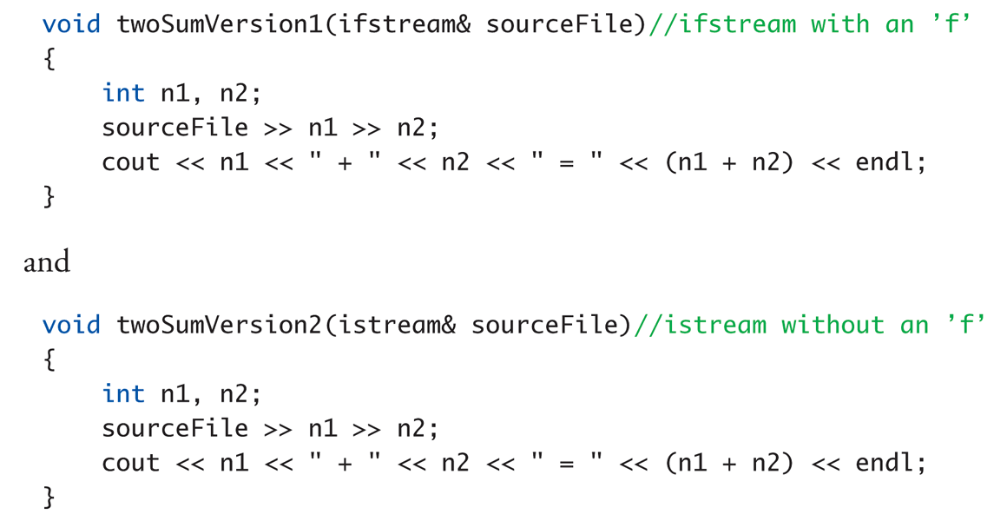
Stream Class Inheritance Example: Display, page 552
Copyright © 2008 Pearson Addison-Wesley. All rights reserved.
12-<number>

Slide 39
Stream Class Inheritance
Example Calls
Considering previous functions:
twoSumVersion1(fileIn); // Legal!
twoSumVersion1(cin); // ILLEGAL!
  Because cin is not of type ifstream!
twoSumVersion2(fileIn); // Legal!
twoSumVersion2(cin); // Legal!
  More versatile
  istream parameter accepts both objects
Copyright © 2008 Pearson Addison-Wesley. All rights reserved.
12-<number>

Slide 40
Random Access to Files
Sequential Access
  Most commonly used
Random Access
  Rapid access to records
  Perhaps very large database
  Access "randomly" to any part of file
  Use fstream objects
    input and output
Copyright © 2008 Pearson Addison-Wesley. All rights reserved.
12-<number>

Slide 41
Random Access Tools
Opens same as istream or ostream
  Adds second argument
  fstream rwStream;
  rwStream.open("stuff", ios::in | ios:: out);
    Opens with read and write capability
Move about in file
  rwStream.seekp(1000);
    Positions put-pointer at 1000th byte
  rwStream.seekg(1000);
    Positions get-pointer at 1000th byte
Copyright © 2008 Pearson Addison-Wesley. All rights reserved.
12-<number>

Slide 42
Random Access Sizes
To move about → must know sizes
  sizeof() operator determines number of bytes
  required for an object:
  sizeof(s) //Where s is string s = "Hello"
  sizeof(10)
  sizeof(double)
  sizeof(myObject)
  Position put-pointer at 100th record of objects:
  rwStream.seekp(99*sizeof(myObject));
  Position put-pointer at n^{th} record of objects:
  rwStream.seekp((n-1)*sizeof(myObject));
Copyright © 2008 Pearson Addison-Wesley. All rights reserved.
12-<number>

Slide 43
Summary 1
Streams connect to files with open operation
Member function fail() checks successes
Stream member functions format output
  e.g., width, setf, precision
  Same usage for cout (screen) or files
Stream types can be formal parameters
  But must be call-by-reference
Copyright © 2008 Pearson Addison-Wesley. All rights reserved.
12-<number>

Slide 44
Summary 2
istream (no "f") parameters accept cin
or ifstream objects as arguments
ostream (no "f) parameters accept cout
or ofstream objects as arguments
Member function eof
  Used to test for end of input file
Copyright © 2008 Pearson Addison-Wesley. All rights reserved.
12-<number>

